Slide 1
Neural Network Basics
How to machine thinks

Slide 2

About Artificial Intelligence
AI is not only Neural networks
Other techniques like:
Search algorithms (DFS, BFS, A*)
Decision tree
Neural Networks
etc

Slide 3
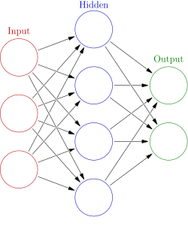
What is the neural network in a computer
Neurons which connected to each other
Columns are the layers
Hidden layer can called as deep layer (deep learning)
Hidden layer can have more than one

Slide 4
Neuron types
Rosenblatt Perceptron
Adeline
Linear neurons (linear perceptron)
Processing element with sigmoid output
Etc
https://www.mateking.hu/
https://www.wolframalpha.com/

Slide 5
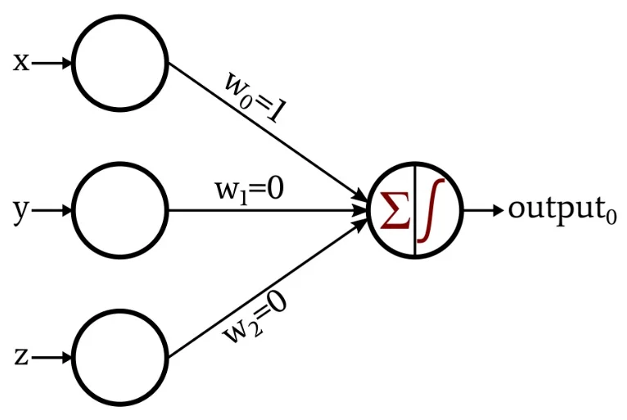
Perceptron - is the most popular artificial neuron
Input data
Weights (Random initialised)
Sum of the multiplication data and weights
Activation function

Slide 6
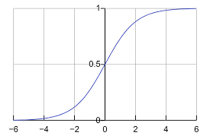
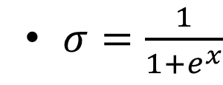
Activation function
The activation function of a node in an artificial neural network is a function that calculates the output of the node based on its individual inputs and their weights
Sigmoid function
Normalize the result
https://en.wikipedia.org/wiki/Activation_function

Slide 7
How does it work
X=Y
14.00
6,7
= 93.74
6.1
6.82
= 41.6
42
0.5
-16.85
= -8.43
-9.2
10.2
= -93.84
1.86
= 8.93
4.8

Slide 8
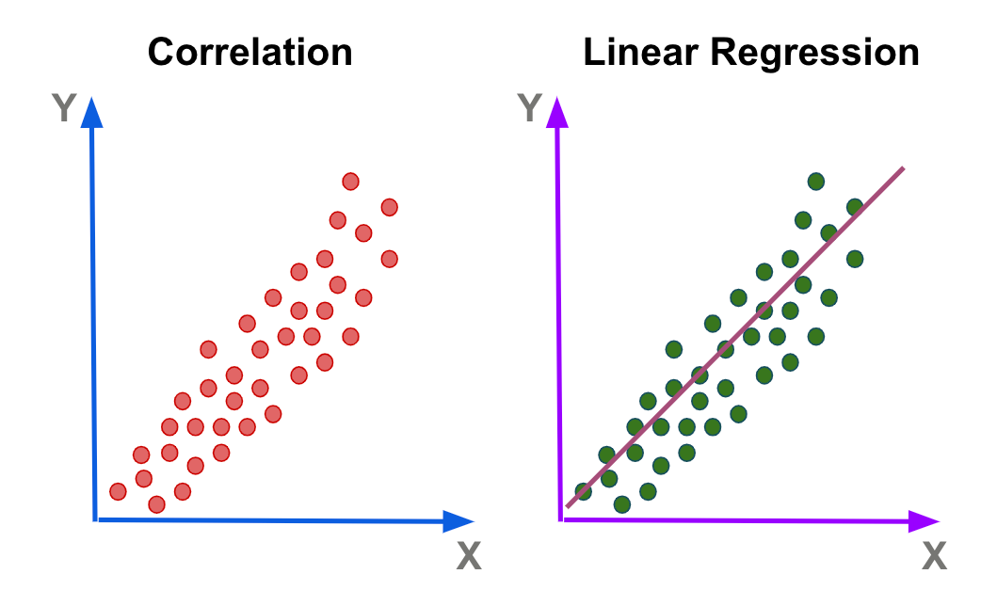
What can we do with it
Lineal regression
Classification

Slide 9
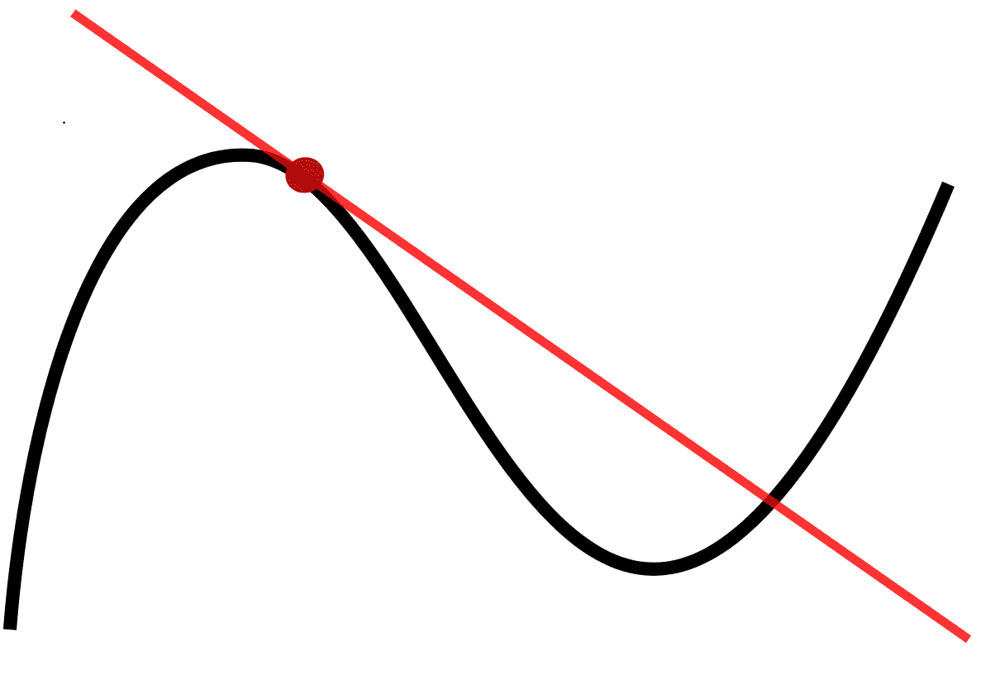
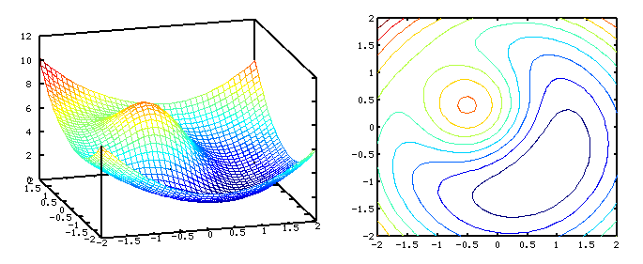
Learning
What is error?
Calculate weights
How can we locate the minimum point?
What is local and global minimum?
Derivate & gradient

Slide 10
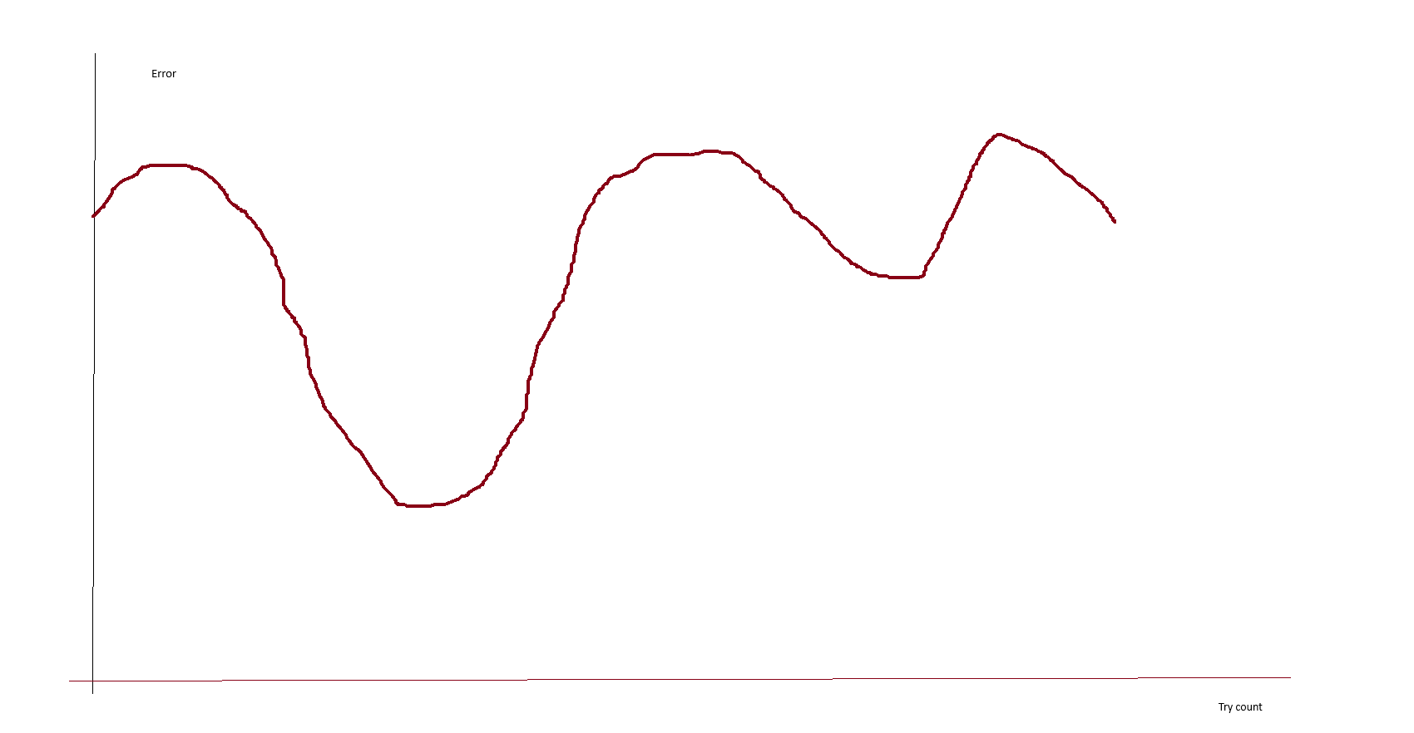
Learning curve
Local and global minimum

Slide 11
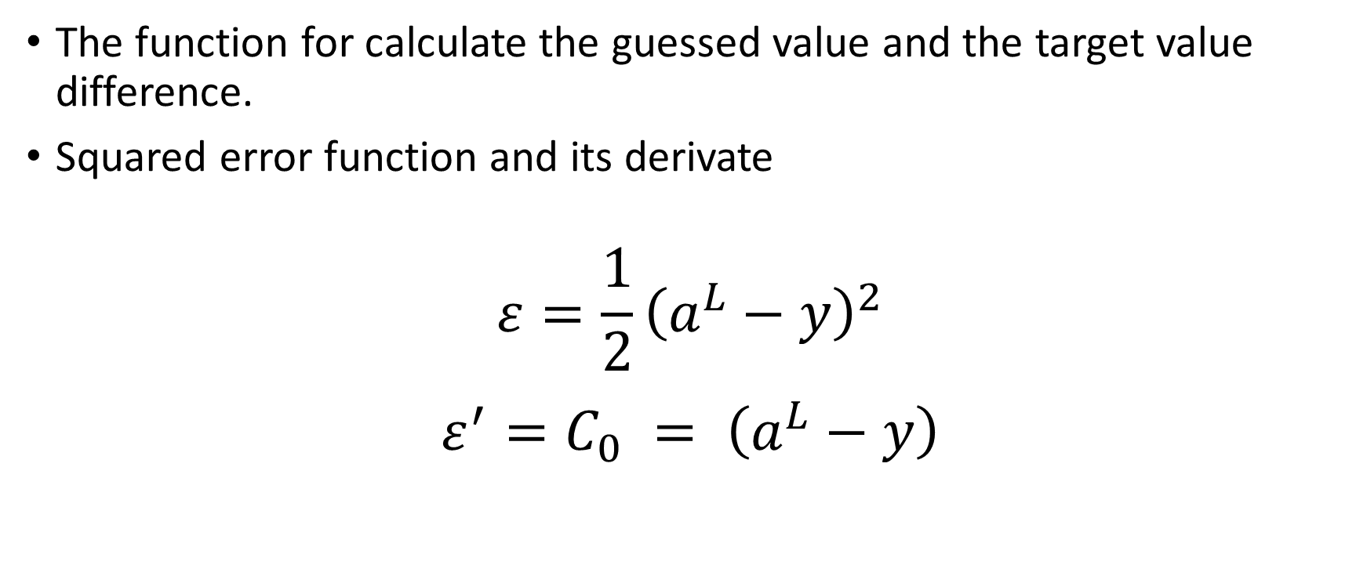
Error functions
The function for calculate the guessed value and the target value difference.
Squared error function and its derivate
$$ε=\frac{1}{2}{\left(a^{L}−y\right)}^{2}$$
$${ε^{′}=C}_{0} = \left(a^{L}−y\right)$$

Slide 12
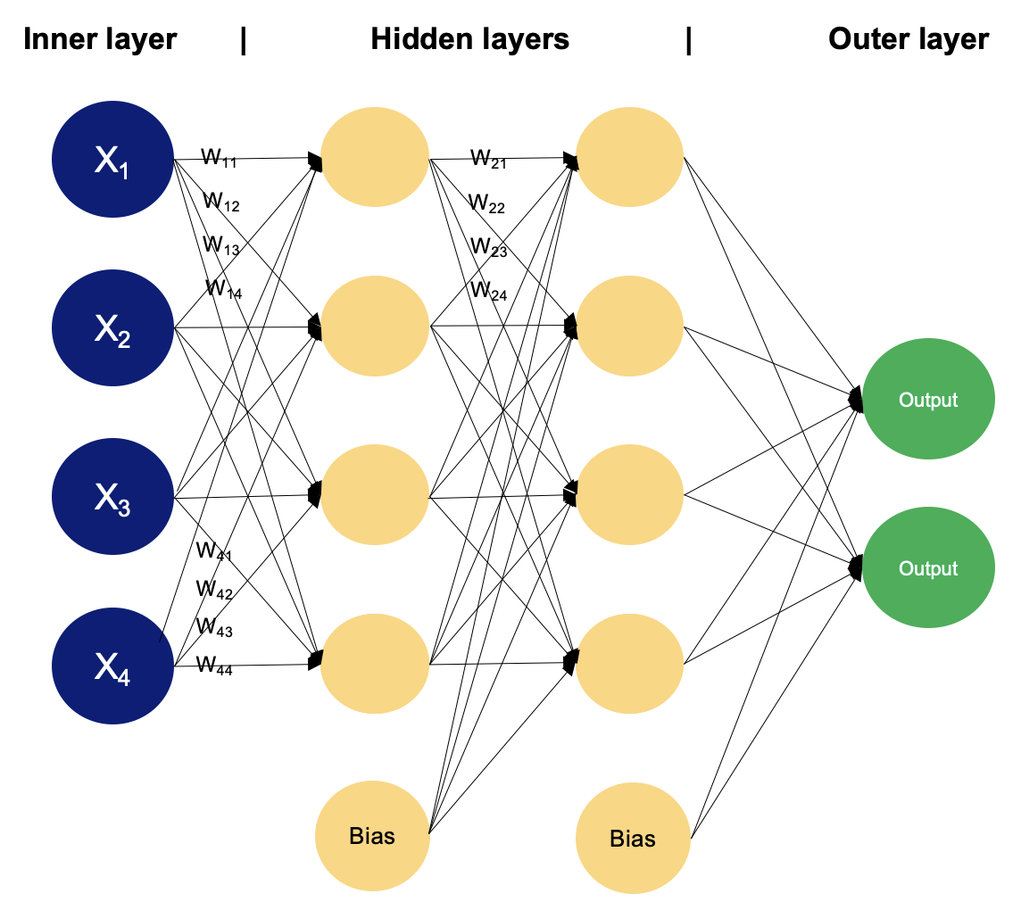
Multilayer perceptron
Input layer (can be tricky)
Hidden layer (deep layer)
Output layer

Slide 13

Back propagation method
The way how we can set the weights trou the MLP
The ability of use come from modern GPUs

Slide 14
How can we use this
We need dataset (huge amount of data)
Separate into 3 parts (learning, testing, using)
How do I solve when there is no numerical data?
Make a loop where give a data row to the network
The network will give a guess
Calculate the error rate
Calculate weights
Try again

Slide 15
How the computer thinking
The weights decide the guess
Many neurons many decisions
Reflex like operation

Slide 16

What next

